Slide 1
RAG DS-17 2024 Guy Yarhi

Slide 2
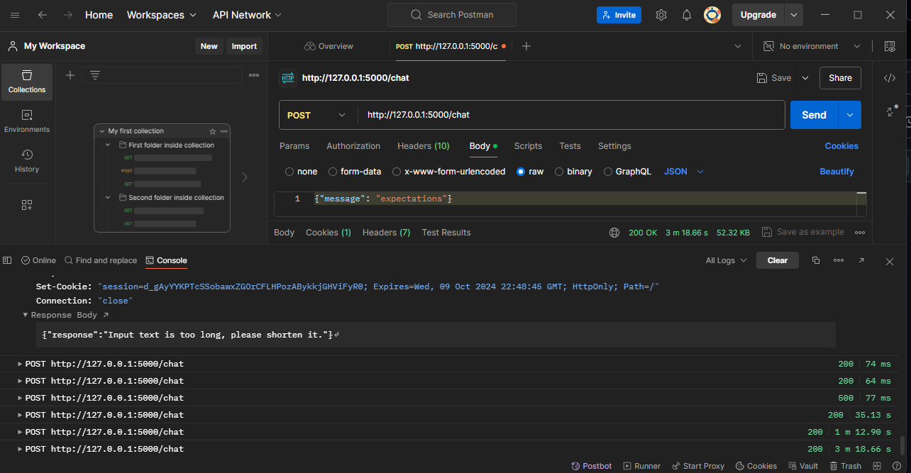
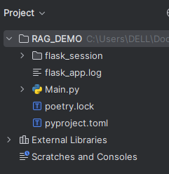
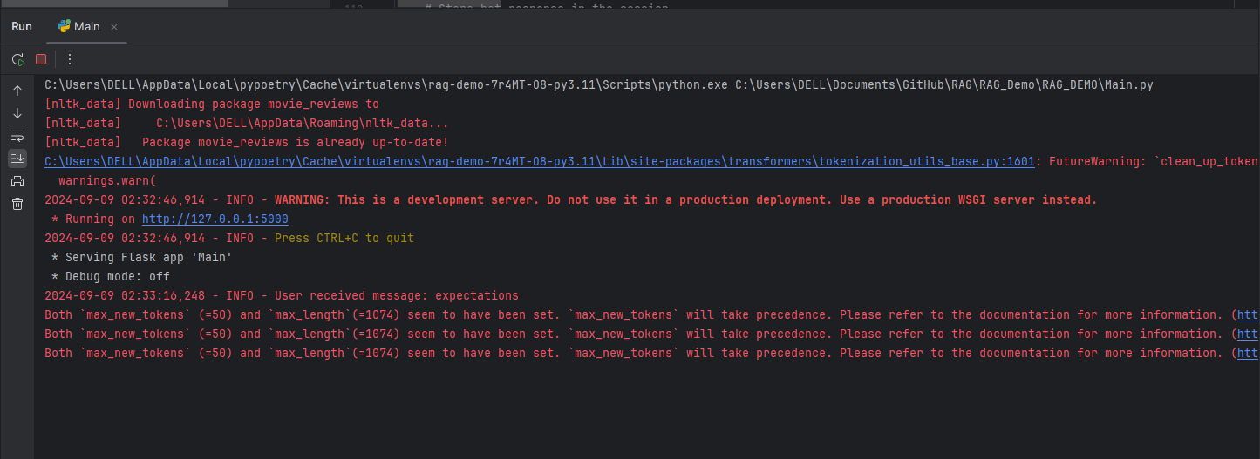

Slide 3
Introduction
Title: Introduction to Retrieval-Augmented Generation (RAG) System
Overview:
What is a RAG System?
Purpose and applications.
Components:
Retrieval Mechanism
Generation Model
Objective:
To enhance text generation by integrating external knowledge retrieval.
Image: TBD
Simple diagram showing the high-level flow of RAG: User Input → Retrieval → Generation → Output.
Hyperlink to RAG

Slide 4

Components: Data Source: Document Database Retrieval Mechanism: Embedding Generation, Similarity Search Generation Model: GPT-2 Model Interaction Layer: Flask Application Workflow: Data Ingestion → Embedding Creation → Query Handling → Response Generation Image: TBD A clear architecture diagram showing the interaction between the components: Document Database, Retrieval Mechanism, Generation Model, and Flask Application.
System Architecture of the RAG System

Slide 5
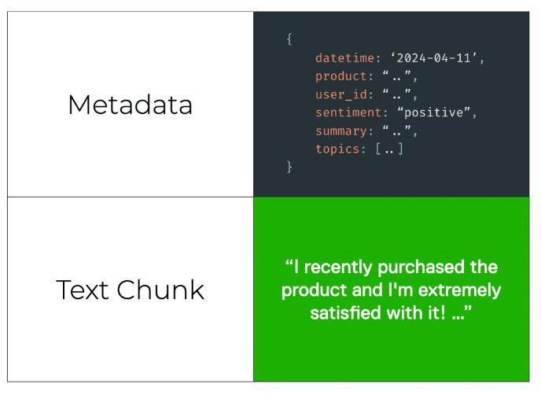
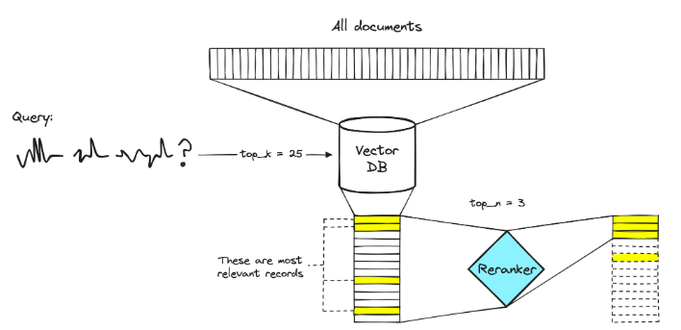
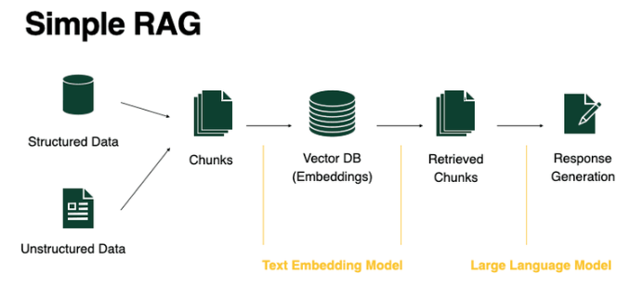
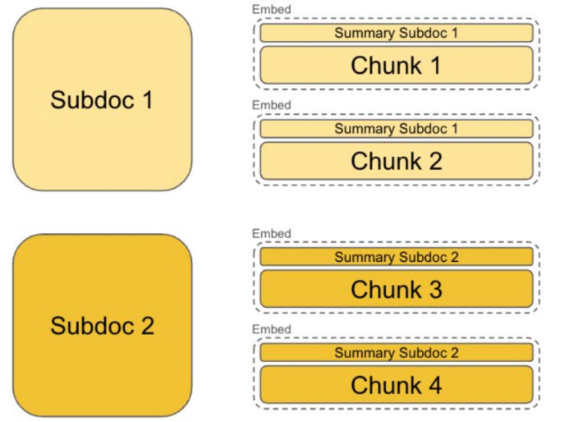
System Architecture of the RAG System

Slide 6

Data Diagram
Confidence-building strategy
Data Sources: NLTK Movie Reviews Dataset
Data Structures: Document Embeddings Document Database User Queries and Responses
Image: Data diagram showing: Raw Documents Processed Embeddings Document Database Query Embeddings and Responses

Slide 7
Data Diagram and Storage
Steps:
1. Data Loading: Read and preprocess text data.
2. Training Word2Vec Model: Create document embeddings.
3. Query Handling: Generate embeddings for user queries.
4. Document Retrieval: Find relevant documents using similarity search.
5. Response Generation: Create responses using the GPT-2 model.
Image: Flowchart illustrating the data flow from initial document loading to response generation.

Slide 8
Word2Vec
Purpose:
Word2Vec is a technique used for natural language processing (NLP) to create word embeddings, which are vector representations of words in a continuous vector space.
Role:
Word2Vec is used to process text data, convert words into numerical vectors, and calculate embeddings for words and documents. It’s part of the backend logic that handles text analysis and generates document embeddings based on the trained model.

Slide 9
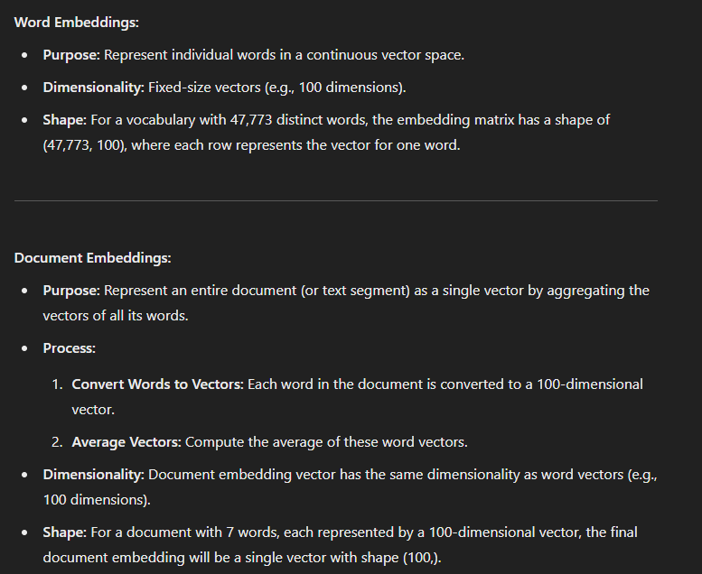
Word & Document Embeddings: Concepts and Dimensions

Slide 10
Flask
Purpose:
Flask is a lightweight web framework for Python used to build web applications and APIs.
Role:
In the context of your application, Flask handles HTTP requests, routes them to appropriate functions, and manages the web server. It’s used to create the interface through which users can interact with your application
(e.g., sending requests to the /chat endpoint).

Slide 11
Integration
System Components and Their Integration
1. Flask Application (WEB API)
2. Word2Vec Model (word embedding model)
3. GPT-2 Model (LLM)
Flask
Acts as the server that processes user input, manages conversation history, and interacts with the machine learning models.
Word2Vec
Generates word embeddings for user input and documents. These embeddings are used to compute semantic similarities and contextualize user queries.
GPT-2
Takes the processed input (which may include user queries and context from relevant documents) and generates human-like text responses.

Slide 12
Summary of Important Functionalities:
Data Download and Loading:
download_imdb_data(url): Downloads and loads a TSV file from IMDb into a pandas DataFrame.
retrieve_imdb_data_and_compare(): Retrieves and filters IMDb TV show data (2020-2023), compares it with NLTK movie reviews,
and prepares a list of titles for further use.
Preprocessing:
Tokenizes documents by removing punctuation and converting to lowercase.
Word2Vec Model Training:
Trains a Word2Vec model on the tokenized documents.
Document Embeddings:
Generates embeddings for each document using the Word2Vec model. Handles documents with no valid words by assigning a zero vector.
Vector Database:
Creates a dictionary to map document indices to their content.
Logging:
Configures logging to record application events.
Flask Application Initialization:
Purpose: Flask is a lightweight web framework for Python used to build web applications and APIs.
Sets up a Flask web application with session management.
Text Generation:
Initializes GPT-2 tokenizer and model.
Generates text in chunks to handle long input sequences.
Query Handling:
get_embedding(query_text): Computes the embedding for a query.
generate_text_in_chunks(input_text, model, tokenizer, max_length): Generates text in chunks using GPT-2.
Web API Endpoint:
/chat: Handles POST requests to generate responses based on user input, retrieves relevant documents, computes similarity, and generates text.

Slide 13
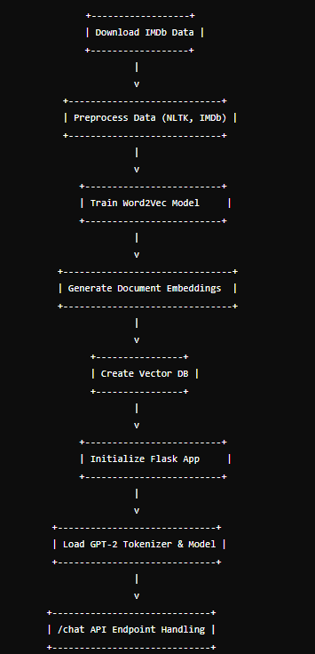
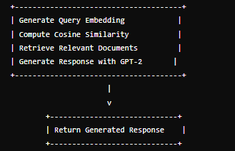
Flow Diagram

Slide 14
Data Diagram
Structures: Document Embeddings Document Database User Queries and Responses Image: Data diagram showing: Raw Documents Processed Embeddings Document Database Query Embeddings and Responseses

Slide 15
Query and Document Embeddings
Purpose:
Transform text data into numerical vectors.
Process:
Word2Vec Model Training
Document Embedding Generation
Query Embedding Generation
Tools Used:
Gensim Word2Vec
NumPy for Calculations
Image: Diagram showing:
Text Data → Word Embeddings → Document Embeddings
User Query → Query Embeddings

Slide 16
Data Diagram
Structures: Document Embeddings Document Database User Queries and Responses
Image:
Data diagram showing: Raw Documents Processed Embeddings Document Database Query Embeddings and Responseses

Slide 17
Interaction with Flask
Title: Interaction with Flask
Overview:
Flask Application Setup
Handling User Input
Generating Responses
Session Management:
Store conversation history
Manage state across requests
Image: Interaction diagram showing:
User Input → Flask App → Query Processing → Response Generation → User Output

Slide 18
Summary
Summary:
Recap of system components and workflow.
Future Enhancements:
Metadata filtering
Reranking models
Model fine-tuning
Scaling and performance improvements
Additional features and integrations
Image:TBD
High-level summary diagram or bullet points summarizing key points.

Slide 19
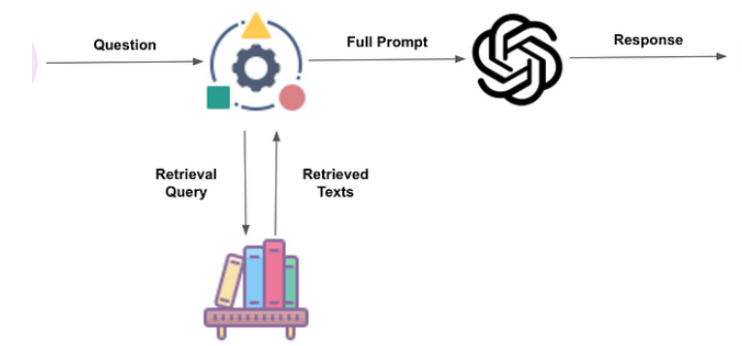
Thank you
Guy Yarhi

